Slide 1

Integra – Hawston Makarios Communities Project

Slide 2
VISION We strive for each learner to reach a high standard of reading with understanding and to teach learning strategies for learners with needs so that they are better equipped to realize their true potential and gift that they were born with. To enhance learning we make use of a brain compatible learning process to change the way of learning.

Slide 3
MISSION We strive towards and environment where learners can achieve success in reading and studying by using a multi-sensory, metacognitive integrated approach. We also strive to give each learner the maximum opportunity to develop in totality and to enhance their self-concept by gaining confidence in their own abilities and gifts. To equip teachers and tutors to make a difference in the reading levels of learners in their classrooms.

Slide 4
BACKGROUND Maude Kemp (Dipl.TOD BA MBD, Phd Ed.) is the Academic Dean of Integra. Maude has 30 years’ experience in Remedial Teaching. She was a finalist in the 2003 National Teachers Awards and was also nominated for business Woman of the year in the category Education and Training. Maude has trained 140 educators in the D2 District Gauteng West in reading methods and strategies and was contracted by the Gauteng Department of Education.

Slide 5
INTRODUCTION OF INTEGRA The main goal for the Integra Reading Strategy is to improve the reading competence of learners because READING is part of nation building. Surveys done showed shockingly low levels of reading ability across this nation. Large numbers of our children simply do not read. Leading world nations pride themselves in promoting reading in all aspects of life – but illiterate people are excluded from much communication in today’s world. South Africa faces many challenges in promoting literacy. It is rare to find schools with well-used general libraries. Many homes have no books. Some classrooms have no books, and even those classes which do have sets of readers, often have them at the wrong level. Poor matriculation results are in part due to the low levels of students’ reading skills. University students – even those enrolled for the languages and the arts – are not proficient in reading. South Africa ranks 148/148 in the Global Competitive Index for Primary Education (2014). We have implemented Integra in Boys town and Girls town nationally as an intervention plan for reading strategy and numeracy that will show remarkable results in a short period of time. Schools at the West Rand have implemented the Integra program with great success.

Slide 6
Therefore a proposal for literacy and numeracy development should cover one or more of the following aspects with the vision of re-awakening reading culture and the mission of transforming the youth: 1. Early intervention and support for literacy and numeracy development. Integra has developed literacy and numeracy program for that is based on early intervention and support for the learners. The aim is to improve the reading level of all learners in the country, including those who experience barriers to learning, because reading promotes confidence as an individual in a modern society, and as a member of a national and world community. It is additional to the curriculum and supports areas of deficit where the foundation is being made strong so that the academic wall can be built with confidence. 2. Developing and enhancing educator competency in teaching literacy and numeracy. Quality education starts with quality teachers/facilitators. Teachers are key to the successful teaching of reading. Teacher training, development and support are therefore a key pillar. One of the most important aspects of Integra is to develop and train educators in assessment and implementation of the program for success. Teachers will receive comprehensive training. Improving teaching quality is the most effective measure we can take to bolster education in this country. 3. Developing and providing relevant material and physical resources. Instructional materials must be accessible to all students, as well as appropriate for increasing their academic achievement. INTEGRA offer extensive enrichment activities related to reading that is often not included in schools, because of the time constraints. The standard is high and comparable with leading world nations. It spans the whole curriculum. 4. Mobilizing community support and establishing partnerships towards improved literacy and numeracy performance.

Slide 7
The INTEGRA Literacy and Numeracy program includes: Building teacher/facilitator and learner leadership capacity through support from literacy and numeracy training. Improving the monitoring and assessment of literacy and numeracy performance. Promote early engagement with reading and mathematics. Provide a strong foundation for future educational achievement. Each educator/tutor will be trained in assessment and will be able to monitor the progress of each learner throughout the year. The educators/ facilitators will help share the responsibility for the education and upliftment of the learners’ reading and mathematical skills. 5. Research, monitoring and evaluation to inform practice. The monitoring and evaluation system for students consists of norm- and diagnostic tests conducted at the beginning and end of the year. It will provide facilitators with a tool for assessing the reading- and mathematics competence of the students in order to determine their level of functioning and their progress. The essential focus of the evaluation is to enable students to read fluently and with comprehension and to understand the mathematical concepts and calculations.

Slide 8
SUMMARY Reading enables us to act creatively and critically in a world which is ever-changing and competitive. Reading provides rapid, ready access to new information and knowledge that will help us in life-long learning.

Slide 9
WHAT IS INTEGRA? It is a Reading and Mathematical Programme developed as a foundation for literacy and numeracy. INTEGRA is additional to the curriculum in the form of extra, intensive interventions in these two areas of deficit that has been of great in this country. INTEGRA enhances reading with understanding, the most important facet in education. If learners can read well with UNDERSTANDING, there will be a positive spill over to all other subjects. Mathematics will also be positively affected by this. Number concept, understanding of operations and mathematical concepts and calculations, are very important for success later on in the high school phase. If the foundation is weak, the mathematical wall will topple over in the high school and learners will experience great problems with mathematics and science. The INTEGRA Mathematical program fills the foundation and basis for mathematics as to undergird these problems that might arise later in the school career of learners. PREVENTION IS BETTER THAN CURE

Slide 10
WHAT WE OFFER IS… 2.1 FOUNDATIONAL READING Material with all the programmes in English, Afrikaans and Mathematics with extra exercises enhancing the curriculum. There are 40 reading programmes per grade with enough reading exercises for the whole year. Training will be given to the educators to implement the multisensory, metacognitive, integrated method with great success in the classroom. 2.2 FOUNDATIONAL MATHEMATICS Touches all aspects of the curriculum. It will help with the clarification of concepts and it will give learners a proper foundation of the concepts and operations. 2.3 ASSESSMENT AND EXAMS Educators will be trained in reading assessment; norm reading tests as well as diagnostic reading tests. This will determine the level of functioning of each learner in the classroom and it will pinpoint reading errors that each learner struggles with. This will empower the educator with knowledge and insight into each learner’s strong points and weak points. All the learners in the whole school can now be assessed by the educators. Two diagnostic mathematical tests for each grade are included in the test battery.

Slide 11
TESTIMONIALS: TEACHER: CHRISTINE LUBBE – KRUGERSDORP TOWN SCHOOL “I have worked with the programme and saw great results in my class. One girl that never wanted to read started reading and all she wants to do is the INTEGRA Reading programme. I saw a change in the reading levels of all the learners in my class. It is a wonderful teaching aid for teachers.” TEACHER: MICHELLE VAN ZYL – WEST RAND SCHOOL “I saw a very positive change in the marks on the report of Ruben since he has been on the INTEGRA reading and mathematical program. He was a slow learner and had lots of reading problems. All the marks on his report went up. I am very happy with the INTEGRA reading and Mathematical program and I am so glad that they have implemented it into the school.” PRINCIPAL OF SCHOOL: MULDERSDRIFT PRIMARY SCHOOL - KRUGERSDORP “I had a Grade 7 learner in my school that has advanced from a grade two level in reading to a grade 7 level in just 3 months. I can recommend the YREAD Reading and Mathematical programme to everyone.” LAETITIA GOLDEN: DEPARTMENT OF EDUCATION: “As I visited the schools that are on the INTEGRA Reading and Mathematical Program, I saw a very positive change in the functioning levels of learners. The educators love to work with the programme, because they get great results. I can recommend it to all the schools.”

Slide 12
TRAINING OF TEACHERS Teachers need to be trained in the assessment and reading skills and techniques. STRUCTURE Material will be supplied Facilitators will be trained in assessment and methods.

Slide 13
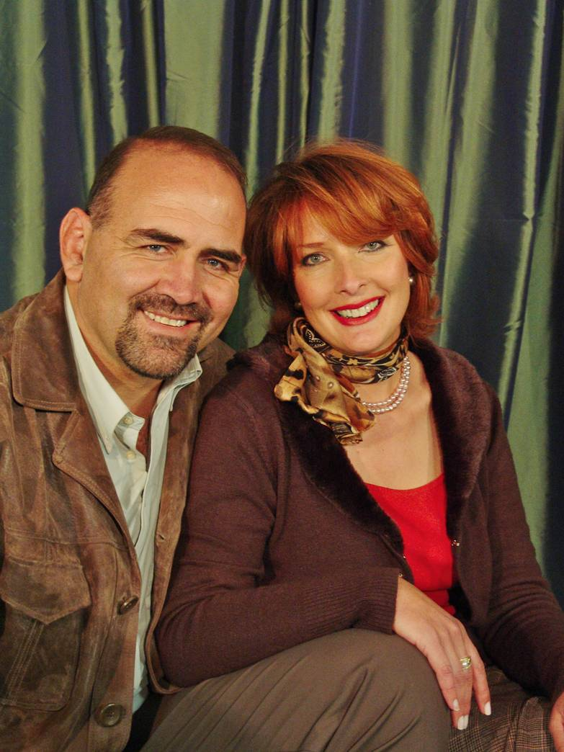

Andre & Christa Cloete
www.makarioscommunities.co.za
info@makarioscommunities.co.za
Andre cell number: 0833972138
Christa cell number: 0722866955

