Slide 1
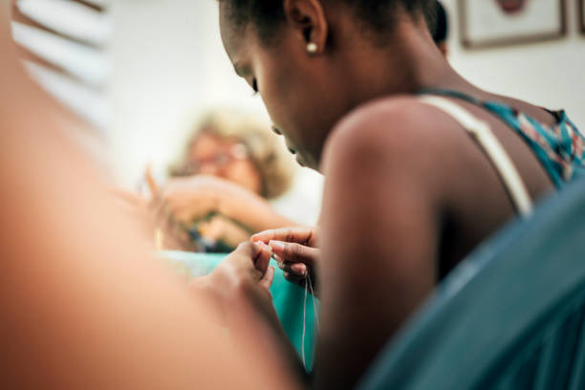
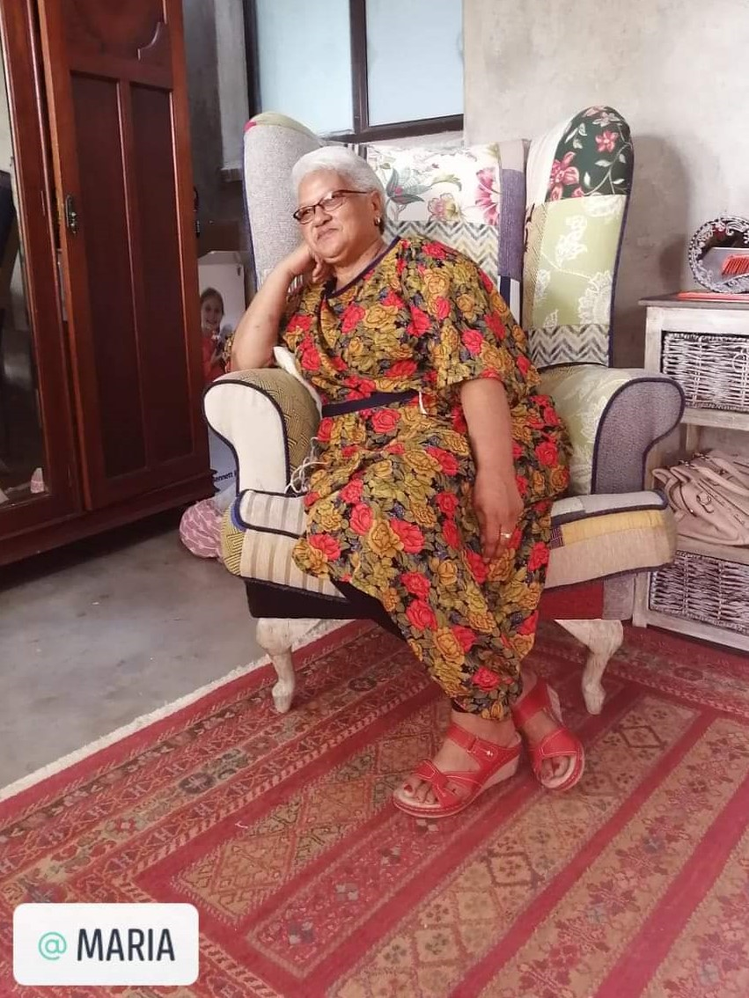
Business Proposal
MAH-Ria’s Sewing and Embroidery Project
Worcester
Prepared By C Cloete & A Cloete

Slide 2
Project Description – our “why, how, who, what & where”
“MAH-RIA’s SEWING & EMBROIDERY CENTRE” is a dream which have been developed over many years. From being a drug lord (in Worcester in the Western Cape) to being transformed to a ‘hands-on’ evangelist, Ria discovered the therapeutic, uplifting and income-generating worth of sewing & embroidery. She became the mother of many – not only in our nation but also abroad – thus the name “MAH-RIA.”
Our aim is to grow the South-African market in textile/clothing as a South African-based supplier in a range of unique clothing- and household items. These items will give new meaning to the word: “functional art”! Exports can follow through social media ‘on-line’ selling or via connections [agents] in other countries, once the South African market proof to be successful. We already have connections in several African Countries.
Our aim is also importantly to uplift woman & men with potential and passion in this field via skill transfer and hands-on training.
Efficacy & profitability will be achieved by consulting specialists in the design of a range of items - as well as utilizing these specialists in the training of these new business entrepreneurs in various skills like the cutting of patterns; sewing; knitting; crochet; beadwork, embroidery of clothing & household items; upholstery; printing etc.
Focus on marketing is vital for sustainability and growth - utilizing the new trend of exhibitions on organic & CRAFT MARKETS all over South Africa as well as marketing via “ON-LINE” selling on social-media platforms and targeting GIFT SHOPS at Hotels & airports; “pad-stalle” etc.
The selection of Industrial sewing machines, Overlocker- & Embroidery machines as well as Printing machine will be based on research and competitive pricing.

Slide 3
Summary of Experts
Chantelle Naude has been an expert @ EDCON for over 20 years in the ‘quality control’ of pattern application & the sewing of clothing items for men-, women- and children’s clothing ranges. She has visited factories for EDCON all over the world and has accumulated fast experience in working alongside all workers in all these facets of production. She is currently an independent consultant with a heart for training and uplifting women especially.
Timothy Naude [Chantal’s husband] & Heila Naude [Timothy’s sister-in –law] are also a well-known interior designers – specializing in household needs like furniture; fabrics; upholstery; curtains; blinds & linen etc.- with a fast knowledge in current trends! The three Naude’s will be a formidable trio in the consultation & decision making of the selected range of clothing- and household articles.
These experts will support RIA in making her dream for such a CENTRE come true. The focus will be on uniqueness; quality & competitive pricing of the range of articles decided on. They will be assisting RIA in a consulting and training capacity.
RIA DREYER is 66 years of age and have loved doing needlework & sewing; embroider; bead-work & crochet from the young age of 17 yrs.! She has made matric farewell dresses and Timothy, Chantal & Heila has also been involved in the design and making of evening-gowns & wedding dresses. RIA has the added value of being trained in the making of ‘African Attire” for the past three years. RIA will be the custodian of this project and ‘hands on’ day to day…
Michael Ankoma from Ghana is the “African Attire” expert which trained Ria and he is available for training classes at this center.
We will also utilize the expertise of a Graphic Designer/s for a Logo/Package design and on-line social media marketing. [Charissa Cloete & Carmen Taylor are young and upcoming designers at hand]. Charissa is studying a Bachelors in Design and she’s currently in her final year @ INSCAPE COLLEGE. Carmen Taylor did an on-line course on Graphic Design.
We would prefer the offices of Johann Jacobs to assist them in a book-keeping system which will be compliant with the financial governance of the head office in Pretoria. Andre Cloete will as CFO of Makarios Communities also keep a close eye on the monthly book-keeping and financial planning of this Centre. Andre has a B. Com degree.
Christa Cloete will also oversee the project as CEO of Makarios Communities next to Ria Dreyer on a monthly – quarterly basis and will also focus on the implementation of staff well-being. Christa is a qualified Occupational Therapist [15 years experience] and have Pastoral/Counseling experience for the past 20 years.

Slide 4
Overview
Ria is a pilar of strength and inspiration in her community
Worcester has very low employment in the Community. Ria stays in the poorest of the poor area. As already mentioned, she has been a “mother”-figure for her community. She has also ministered locally and Internationally. Her testimony as an ex-drug-lord in the W Cape flats, have opened doors for her to minister and help these areas with understanding and insight. They have even made a film about her testimony.
We have previously helped Ria with sewing machines which she bought for an outreach in Malawi and in Worcester.
With assistance from our network of experts, we can successfully help this community to operate as a training and commercial sector. This upliftment project can operate as a self-sufficient enterprise.
The expansion of this project can lead to a broader vision of food-security, education, etc. [also supported/funded by profits from the Sewing- & Embroidery Centre]. It is Ria’s “Blue-Sky local community village” vision to marry this Sewing & Embroidery Center with projects like:
*vegetable tunnels & fruit orchards for the selling of fresh & preserved products
*Egg & Broiler production [ Ria has this fun idea where tourists/client's can run & catch their own chicken which are then slaughtered in a little abattoir ‘on-site’]
*To have a ‘farm/ road stall’-style shop & restaurant – utilizing the fresh produce as well as other local produce. The restaurant will also have a conference area and she wants to groom her sewing and embroidery center to be so sufficient that conference attendees/ clients can just come in for measurements and have their selection in the “clothing range’ created within a short space of time.
Notes:
May require more than one slide

Slide 5
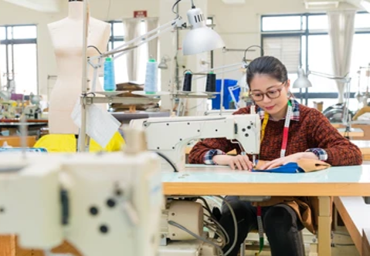
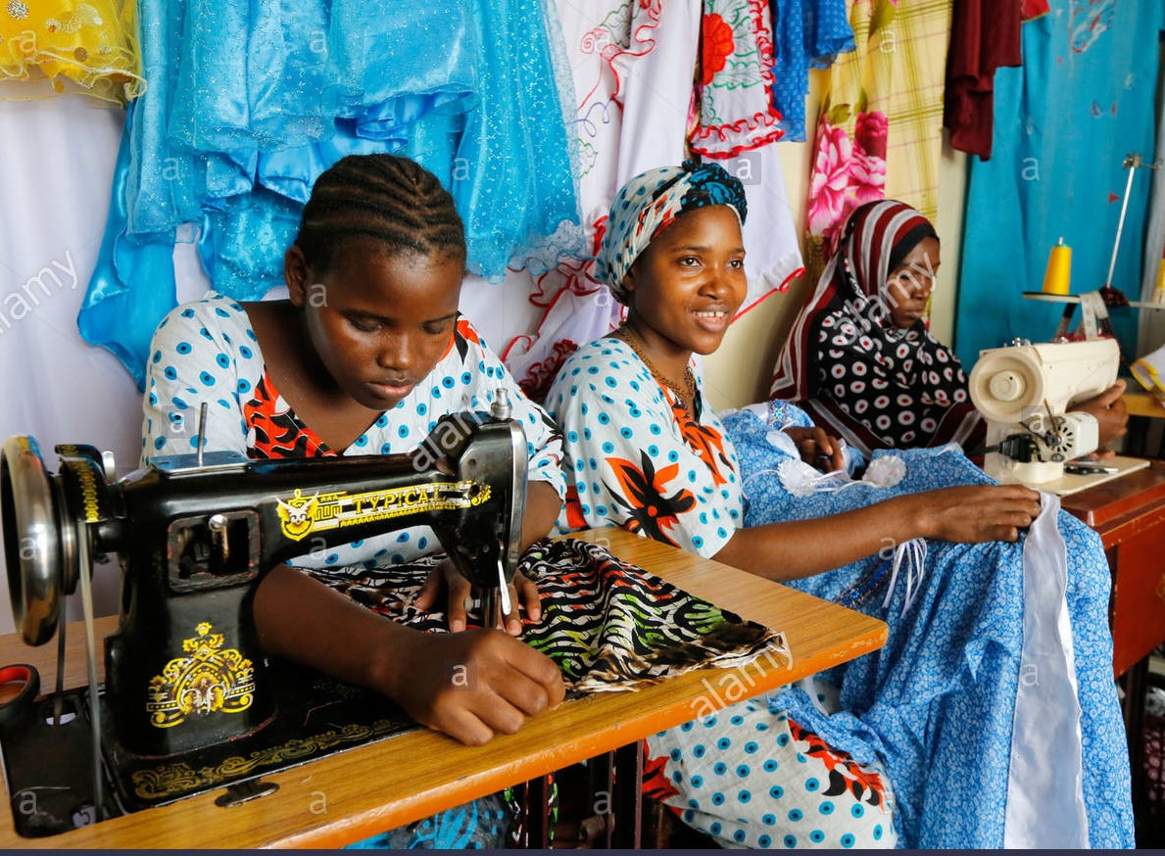

Slide 6
Objectives
MarCeta Training Facility in the Textile and Food Production
We want to create an industry in the clothing- and gift market by empowering the trainees in this upliftment project
Skills transfer and training for the community is the main objective
Every family needs at least one member to earn an income to help that family survive
Involving the community by creating job opportunities and inhouse training
Create Trust Fund / ‘Stokvel’ for the workers allowing them, under guidance, to create financial wealth for them and their families
Alleviate poverty in our growing unemployed society
Bringing hope to the families.
Entrepreneurial opportunities to the trainees

Slide 7
Market Analysis Summary
Recent market analysis suggests that we focus on localization in our products available. To grow economy and alleviate unemployment we need to import less and produce local.
We can stimulate sales through networks [using agents or supplying consignment for applicable shops] in our local environments and as already mentioned, also through on-line sales via social-media platforms.
Our experts know the market trends and demands which can guide us into the correct market segments.
Developing of niche markets will be our main objective to stimulate these markets

Slide 8
Success Factors
The successful attraction of funds
Empowering workers in the community with optimal training and skills transfer
Identifying the right building/grounds that can accommodate our needs and be visible to community members & tourists
The continued growth in the supply of needs/demands for clothing- & household products/items… as well as a focus on the ‘special / corporate gift’ market.
Compliance with the broad-based socio-economic empowerment act
The continued focus to birth new, related businesses with profits (after costs) in Ria’s ‘Blue-Sky’ community village farm/road stall vision.

Slide 9
Implementation
Find the right building for the project with enough space for the factory. Allowing for a display area for walk-in clients; fitting rooms; etc.
Sourcing of correct machines / tools / materials (already used our experts to identify the machines/furniture/tools needed)
Identifying/selecting the first candidates for training
Business plan and strategy to identify market
Training materials
Notes:
May require more than one slide

Slide 10
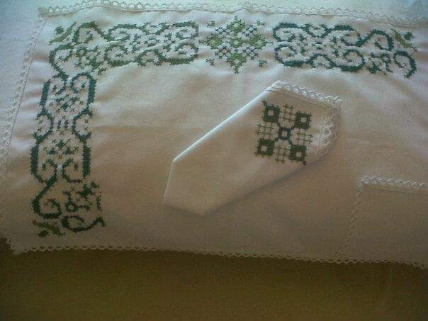
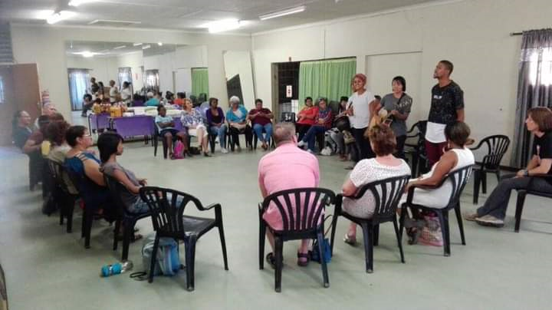
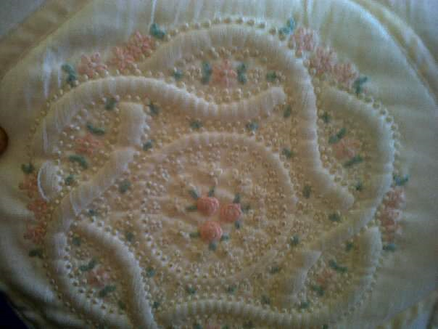
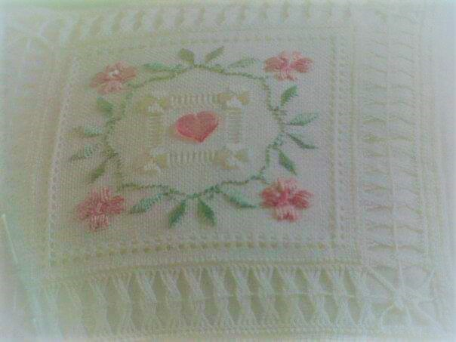
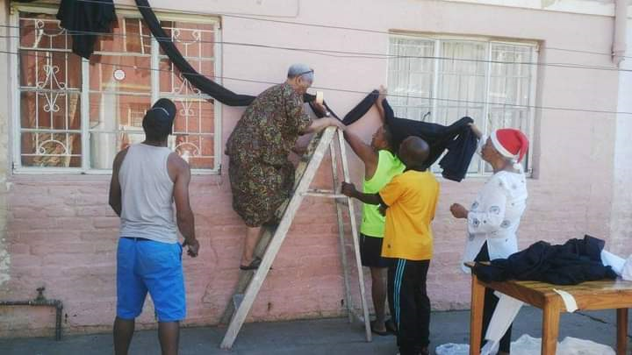
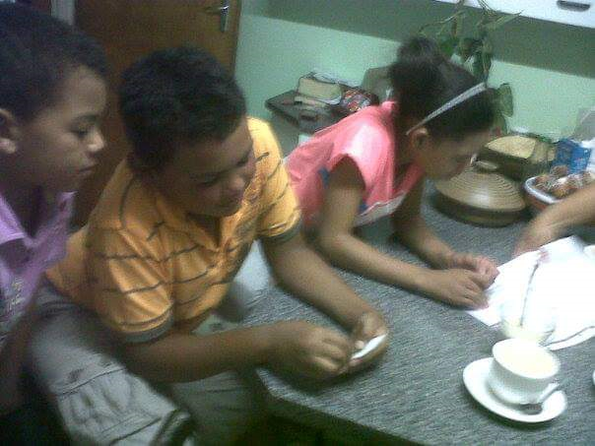
Ria’s Ministry & Projects

Slide 11
Makarios Communities - “ Mah-Ria” Workers Trust
Our main goal is to educate and empower the workers to life a holistic, healthy lifestyle. Providing meals for the trainee-period & shelter for their unattended pre-school children until they earn an income, should be strongly considered.
The trust can include the following but are not limited:
Hospital Plan
Funeral Cover
Life Insurance
Education Fund – Bursaries (for their children)
Annual Profit Sharing
Percentage of profits payable on Investment/s - approved by the trust

Slide 12
Project Team (Personnel)
Ria Dreyer
Project Leader / Buyer/seller
Supervisor
Overseer
Tim & Chantel Naude
Experts/Business Consultants
Trainer
Worker 2
Trainer
Worker 1
Worker 3
Worker 4
Christa Cloete
Overseer
Trainer
Worker 5
Worker 6

