Slide 1
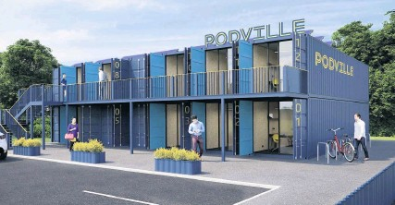
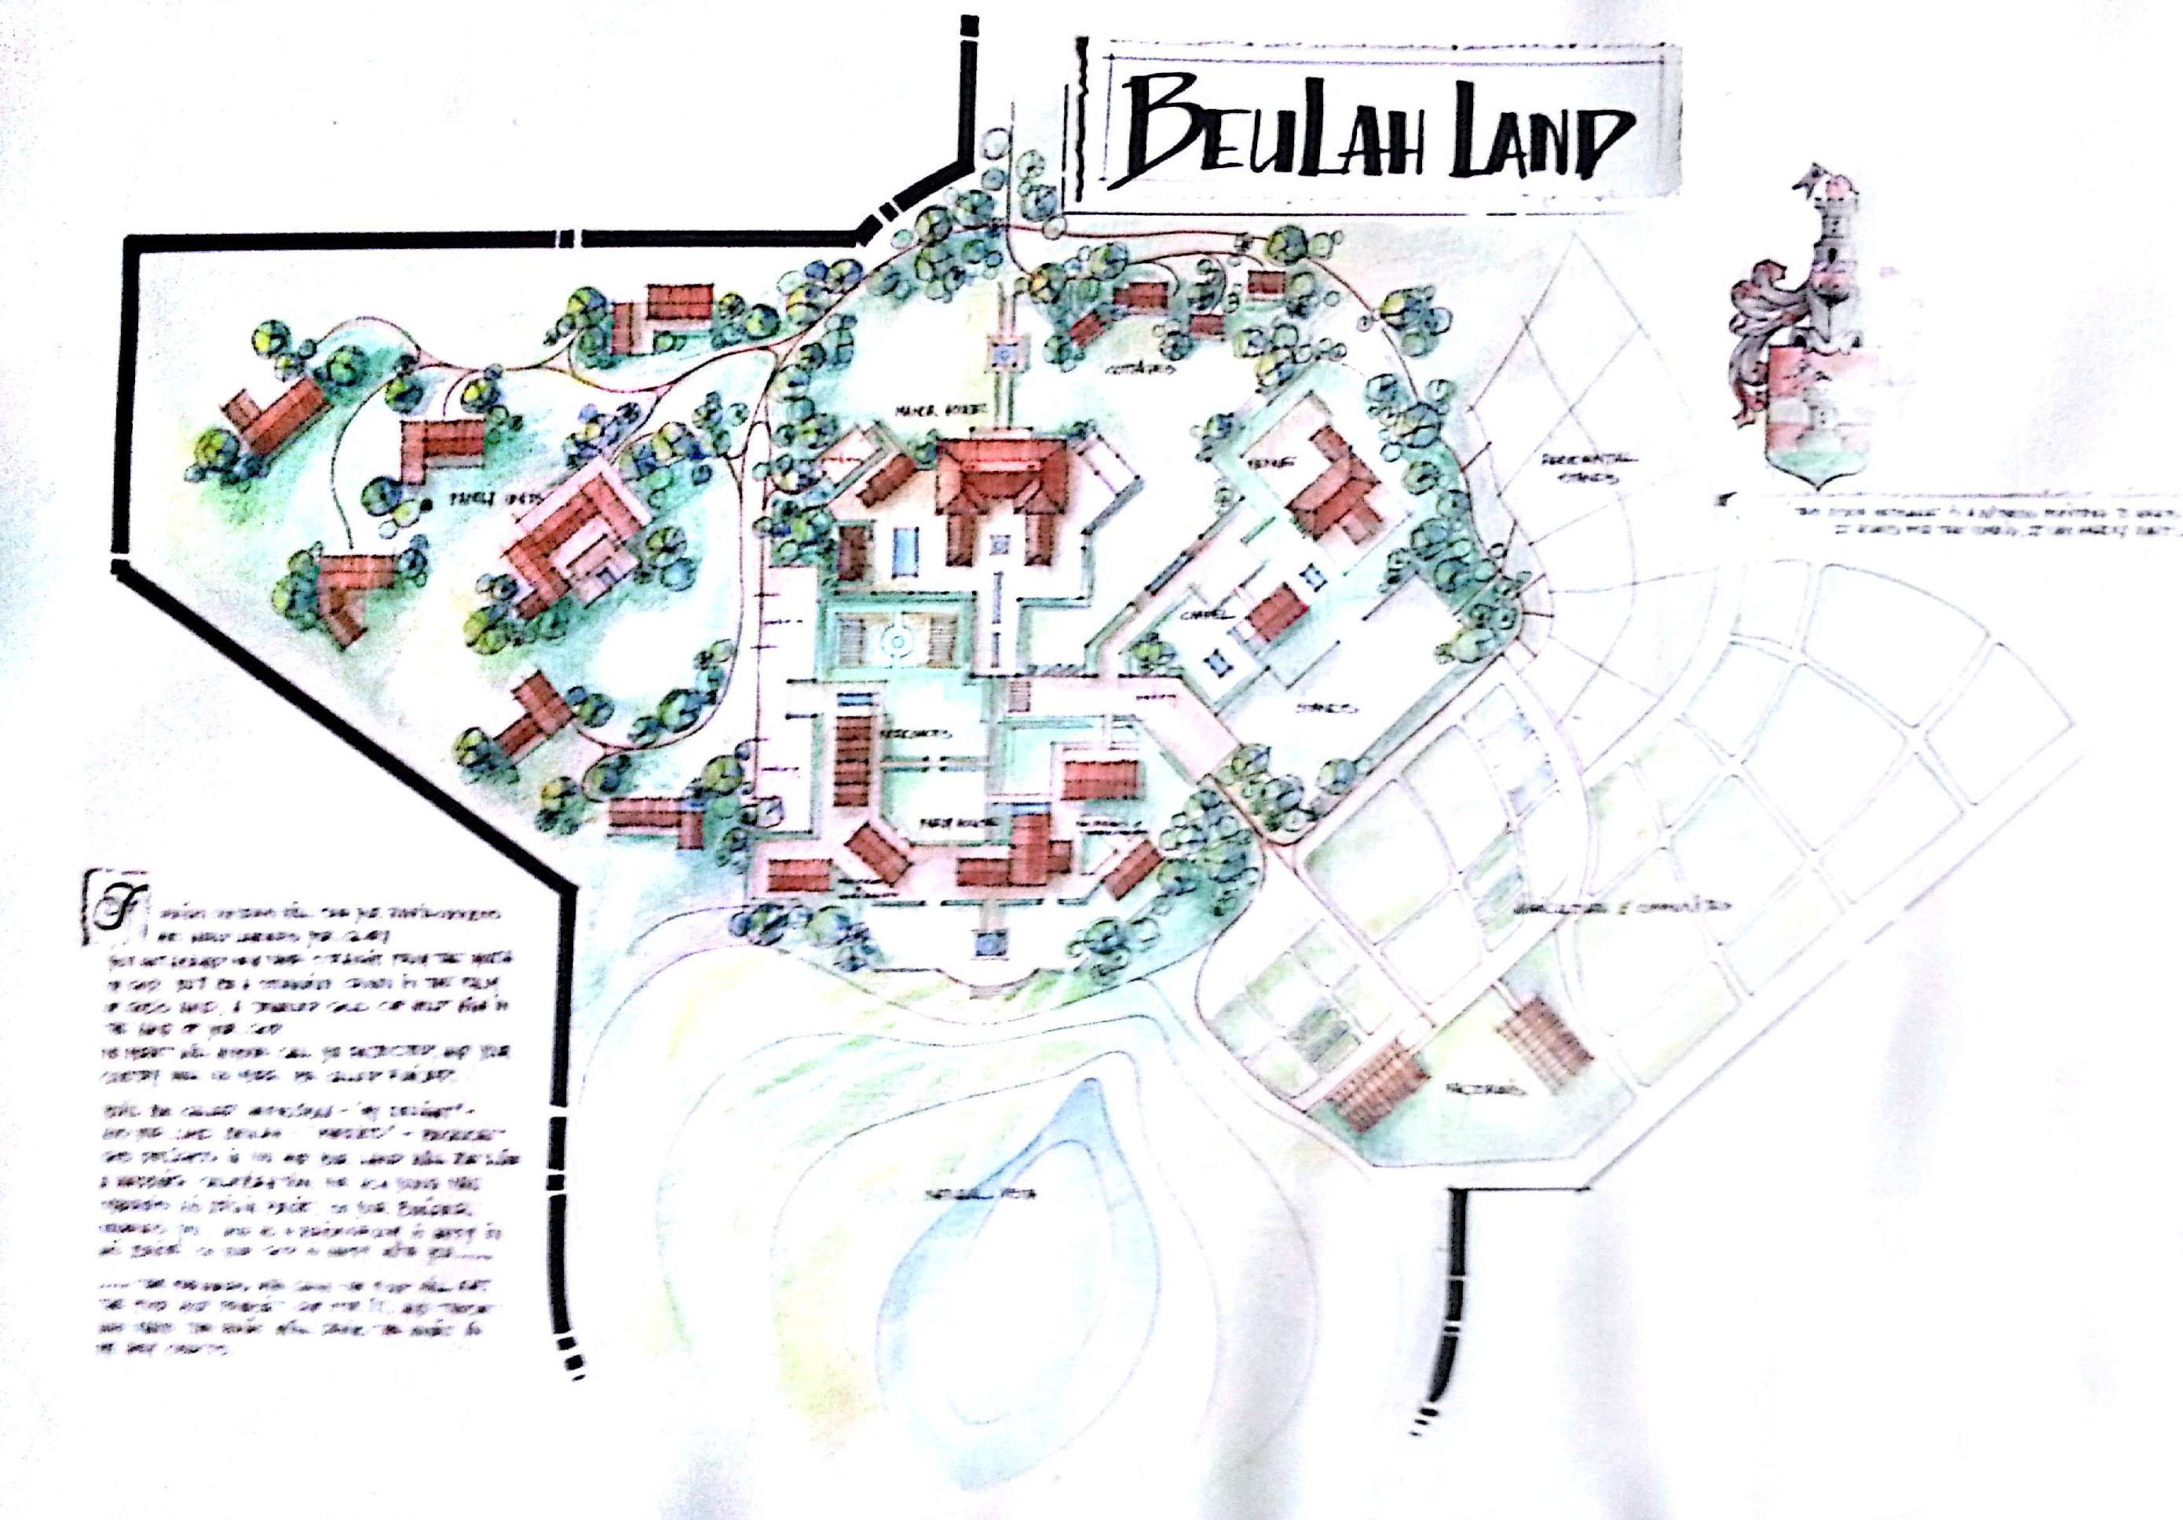
Business Proposal
Stanford Training College
Industrial and Agri Training Hub

Slide 2
Project Description
We as Makarios Communities have community connections and partnership over South Africa and Africa. We currently are committedly involved with the Western Cape area with multiple partnerships. We want to start a MarSeta College site in Stanford. We have the option of Buying Industrial land for R3.7m (4500sqm) or the farm which is R6m (5.2ha). Both sites are great options, but the farmland has enormous potential for development as it can also be rezoned for stands as town development. We can develop this land into a full-blown Industrial and Agricultural training hub.
Our objective and vision is a blueprint sustainable training model that can be developed by the overseeing trainers & on-site students of the MerSeta college/Agricultural training hub – in a practical way, mastering every skill. These trainees can be utilized in developing this project which in return creates employment. This hub can also be a tourist attraction that allows the student to earn some money with their “newfound” skill. Tourist travel from Hermanus through Stanford to Gansbaai for shark cage diving etc. The picturesque, quaint village–like town (Stanford) compares to the “Clarens” of the Overberg-area. There is also a lot of wine-, cheese & wedding/guest farms in the area. This facility can be used for multiple community training purposes; hospitality; recreation and ministry. I have always seen a vision of engaging the community to become part of a life-changing movement that impacts lives. In the process we engage young and old as we make the community thrive through empowerment skills.

Slide 3
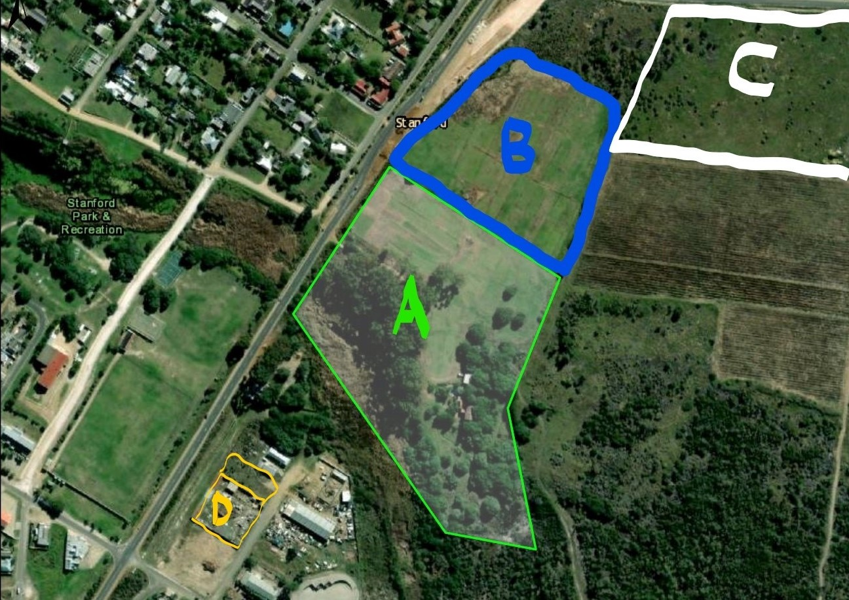
Stanford Site Plan
A – 5.2ha farm
B – 99 Year lease property that
can be acquired from local
Government
C – Local Businessman seeking
Development partner for
development of Hotel and
Conference facility
D – Industrial property 4500sqm

Slide 4
Overview
The decision must be made about the properties at hand. The 2 properties are:
The Industrial Property [Property “D” on previous map] will allow for Training College and maybe 1 or 2 vegetable tunnels. The facility will then be a more formal training venue which will be utilized for trainers and trainees. [This option does however not compare to the potential of the next farm property - as mentioned on previous map as Property “A”]
The farm property [Property “A”] will allow for a Training venue for both Industrial- and small-scale Agricultural trades like Bio-char production for healthy fertilization; Vegetable/Herb tunnels & -gardens; Nut-trees; Olive groves; Bee-hives & keeping; Egg & Broiler; Buffalo grass for selling and grazing of life-stock etc. [The Buffalo grass business is already existing.] This development can also be utilized as a tourist attraction with Coffee and Bakery/Gift shop - selling local produce, incl. Deli & Meat products. A nursery can also be developed adjacent to the shop as part of the garden attraction. Trainees & qualified workers can sell their products and it can be advertised as a local empowerment attraction. A broader variety training can thus be made possible.
I have included R5m for development cost of the venue which can be Industrial style with containers as the shops and workshops. I have a family member which had designed the Container Business Mall in Melville. (27 Boxes) www.27boxes.co.za This amount is not a lot – considering the variety of projects which can both be used for training and job-creation in industrial; agricultural and hospitality trades. Importantly: We can also raise finances by selling stands on the farm as part of a Farming and Educational Community Estate. A recreational & live-entertainment facet can be added to make this a holistic community development for visitors and those living/working there!
Notes:
May require more than one slide

Slide 5
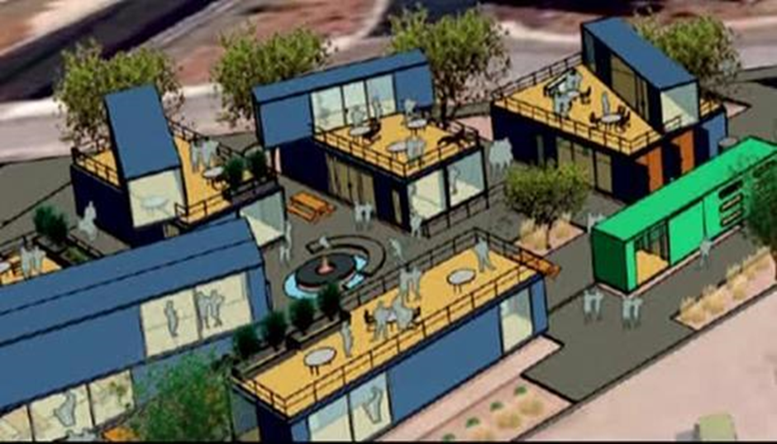
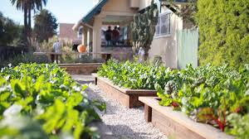

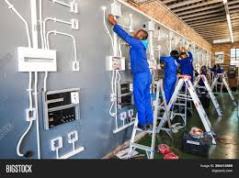


Slide 6
Objectives
The primary objectives are:
Create an environment to learn and improve in all facets of society.
Alleviate poverty and training Entrepreneurs in the workplace.
Holistic training venue that will include all areas of family living. This will include Job skills training; Finances and Budgeting; ‘Rainbow Generations’ pre-school play & remedial program + Bible-program; ‘Integra’ Remedial Education for Gr1-7; Bible college training; Health and Fitness; Family Health and Recreation; Community Well-being; etc.
Tourist attraction to Educate visitors as well as Commercial opportunities for products produced & manufactured on the venue.
Self-sustainable model that can be duplicated in other areas.
Off-the-grid Model that improve Carbon Footprint for generations.
Innovative Hub for creativity.

Slide 7
Market Analysis Summary
Recent market analysis suggests that more and more people must enter the Entrepreneurial sector as unemployment figures are escalating. However, looking at the state of our deteriorating country, the lack in certain trades are overwhelming.
Stanford has very little to offer for the community. Only the hospitality sector and farming community attract opportunity for the workforce. These communities have stayed in this area for life.
The venues are just opposite the “Skema”, which houses the Community in need.
We have been in the area for 7+ years and have come to learn the politics and influences of the Community. I personally have had the opportunity to train up Church Leaders in the area for a year. I also coached the Stanford Rugby Team in the “Skema”. Our Network have successfully piloted the following projects – Growing Oyster mushrooms from alien substrate, Producing Biochar from alien wood, Leadership Development and Training, Vegetable and Fruit tree production and preserves, etc.
We have developed a network of contacts with like-minded ideas.

Slide 8
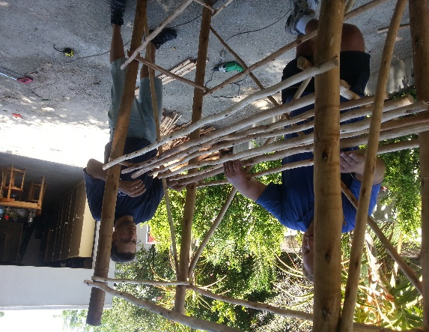
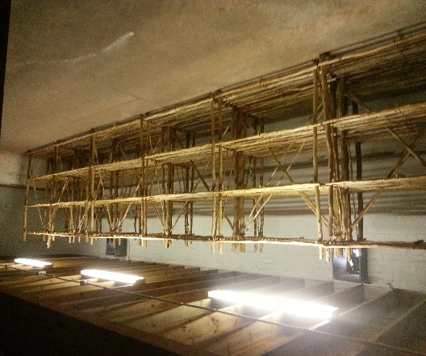
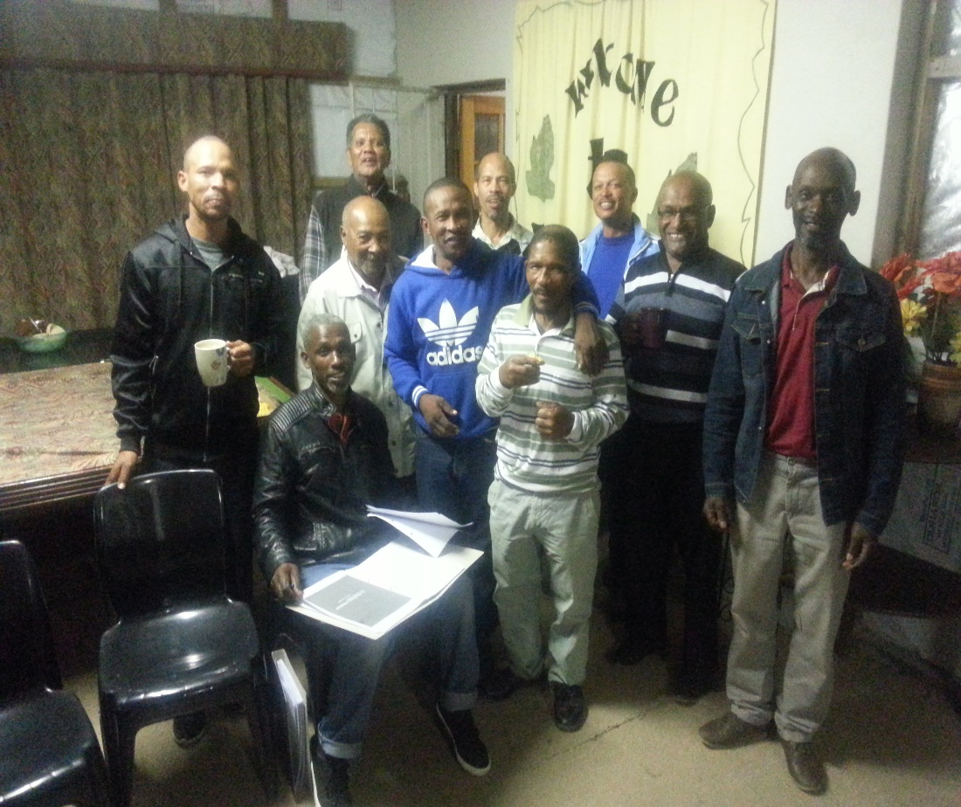
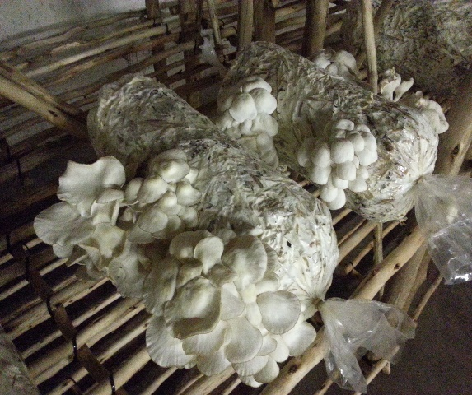
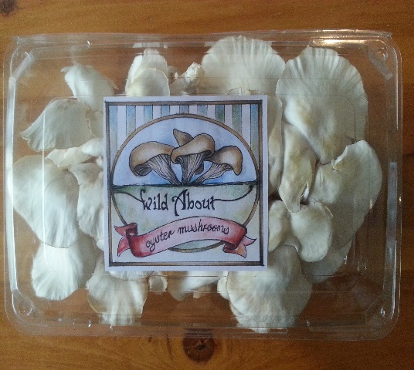
Some of our Projects in Stanford
Oyster Mushroom Project
Leadership Training Stanford

Slide 9
Success Factors
The successful attraction of funds for development of venue.
Optimal utilization of the opportunities of the land and resources of the area.
Land availability of 5.2ha [Property A on map] with irrigation rights and a natural spring – right across the “Skema” [area in need of upliftment].
The continued growth and demand for training and being part of a life changing opportunity to make a difference.
Maintaining good relationships with the community leaders.
Educational Blueprint that will inspire community.
Compliance with the broad-based socio-economic empowerment act.
Empowering workers and the community with skill transfers and training.
Ensuring wellness and decline in behavioral disfunction due to a variety of mental/psychological- & Spiritual education; job-creation; community participation and recreational facilities and performing arts .

Slide 10
Strengths
Diverse expert team of multi-talented leadership and contacts with a heart for community advancement and development
Farm has 5.2 ha irrigation land with ample water and space for multiple training solutions.
Locals already familiar with us.
Low-cost operation that is very simplistic to manage.
Strong demand for trained staff.
Excellent location in town.
Community leaders already sold to solution.

Slide 11
Weaknesses
Long term funding can hinder effective progress
Politics
Cross Cultural Training Understanding

Slide 12
Opportunities
There are no other training facility in the area
Making a lasting difference in the rural communities that can serve for a Blue print model for others to adapt
Setting a stronger local market for local producers – Proudly local
Huge gap in the market for free range products
Consumers are seeking healthier lifestyle and dietary foods for healthier lifestyles
Local economy will benefit from this venture, through job creation, wealth transfer to locals and under privileged community
Creation of secondary markets for the locals
Tourism attraction and education tool for children

Slide 13
Threats
Political instability and unrest
Greed and jealousy in local community and markets
The next public related challenge
Environmental regulations (land, air and water)

Slide 14
Implementation
Drawing of plans for site development
Land preparation for fertilizer and planting
Irrigation installation (4 – 6 weeks)
Boundary fencing (6 – 10 weeks)
Ordering of Containers
Commence building and erection of workshops
Erecting of tunnels
Implementing livestock like chickens and geese
*This is an estimate time frame which can change depending on labour time and weather conditions
Notes:
May require more than one slide

Slide 15
Makarios Communities Commitment
The Company commits to job creation – skills development, entrepreneurial development and poverty reduction
This Business intuitively underpins its commitment to broad-based black economic empowerment
The Company will promote the development of job specific skills, upgrading service delivery levels
Opportunities for committed employees to develop skills and receive promotion once qualified will also promote social upliftment of community, thereby assuring their future career development and entrepreneurial mindset and employability
The Company will promote a non-racial, non-sexist environment, in which cultural and personal diversities are recognized
Because of high moral values and honor that is unashamedly promoted, each person can have a respected & recognized position in the Company

Slide 16
Makarios Communities Workers Trust
Our main goal is to educate and empower the workers to life a holistic healthy lifestyle
The trust can include the following but are not limited:
Hospital Plan
Funeral Cover
Life Insurance
Education Fund – Bursaries (for their children)
Annual Profit Sharing
Percentage of interest payable on Investment made by the trust

Slide 17
Project Team (Personnel)
Christa Cloete
CEO and Project leader Integra
Andre Cloete
Project Leader
Johan van Rensburg
Project Coordinator Chickens
Training Supervisor Agri
Training Supervisor Trades
Farm Worker 1
Worker 3
Worker 4
Jaco Barkhuizen
Project Coordinator Leadership
Theuns Engelbrecht Project Coordinator Tunnels &Veg
Martie v Rensburg Project Coordinator Admin
Farm Worker 2

